Slide 1

Indian Institute of Information Technology ,Sricity ,Chittoor
BTP- 2 Mid Project Evaluation
B21SPK02

Slide 2
Title of the project
Fast and Efficient D-Flip Flop
Under the guidance of
Dr. Siva Prasad Kotamraju
Team members
Nanubala Gnana sai (S20180020225)
Sai Harjun.R (S20180020239)
.

Slide 3
Agenda and Scope:
Brief discussion on D-Flip Flop.
Why a fast and efficient DFF is required.
Gate-Diffusion-Input Technique.
GDI-DFF circuit and it’s working.
Challenges faced.
Future scope.

Slide 4
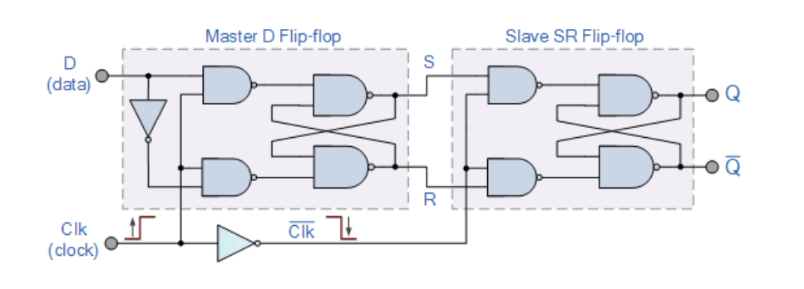
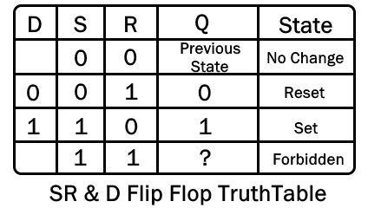
D-Flip Flop
A D-Flip Flop is an extension of the SR-Flip Flop which has a single input.
A Master-Slave D-Flip Flop cascades two SR-Flip Flop and relays the input.
Used in: Data latch in register frequency division etc.
It’s truth table is given as:

Slide 5
Why does a fast and efficient DFF Matter?
DFF are used heavily in memory storage systems and sequential logic.
Need to reduce:
Propagation Delay
Power dissipation
Number of transistors
A low complexity circuit with less gate area and low power-delay product is desired.

Slide 6
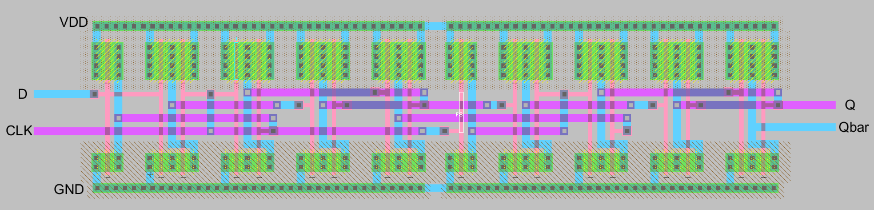
Master-Slave D-Flip Flop
Layout: Used Electric GNU to create Layout.
Dimensions: PMOS W: 20 L: 2, NMOS, W: 10, L : 2. Unit: micron

Slide 7
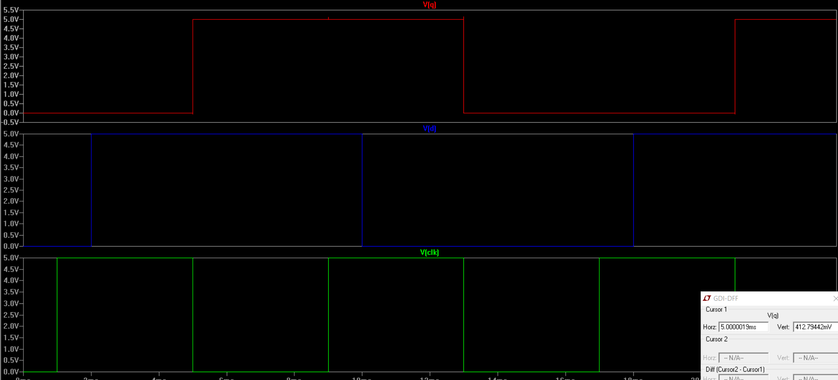
Master-Slave D-Flip Flop
Graph:

Slide 8
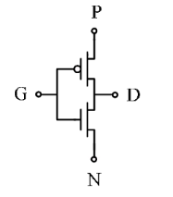
Gate-Diffusion-Input (GDI)
The GDI method consists of a single cell shown below. It has four terminals:
a) G: The common gate between CMOS and NMOS.
b) P: Input to the source of PMOS.
c) N: Input to the source of NMOS.
b) D: The common diffusion node of CMOS and NMOS.
Can implement various logic gates by taking any 3 as input port and 1 as output port.
The GDI-DFF circuit uses two kinds of gates:
a) GDI as a MUX.
b) GDI as an inverter (CMOS Inverter).

Slide 9
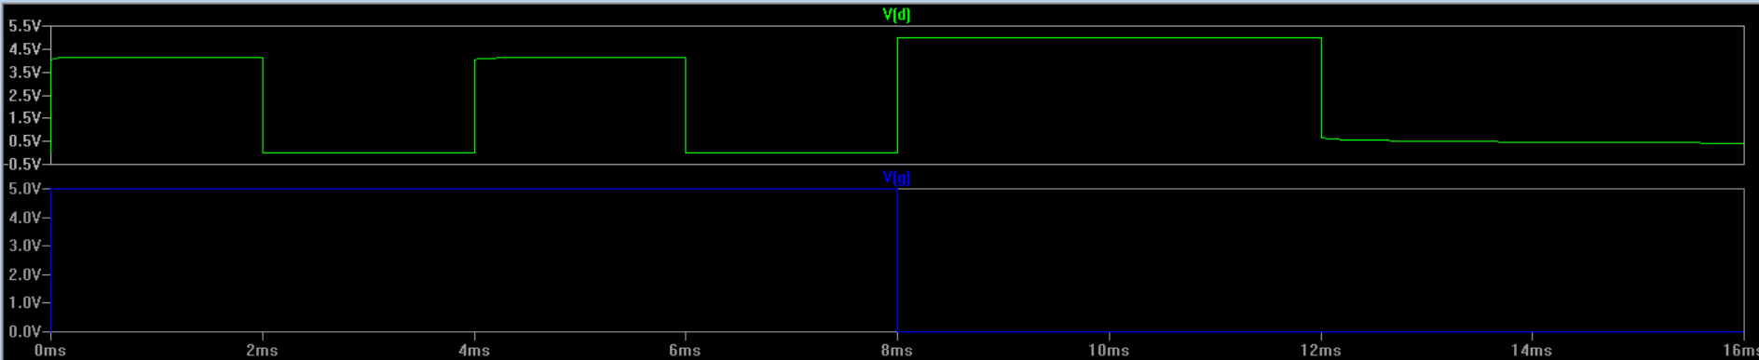
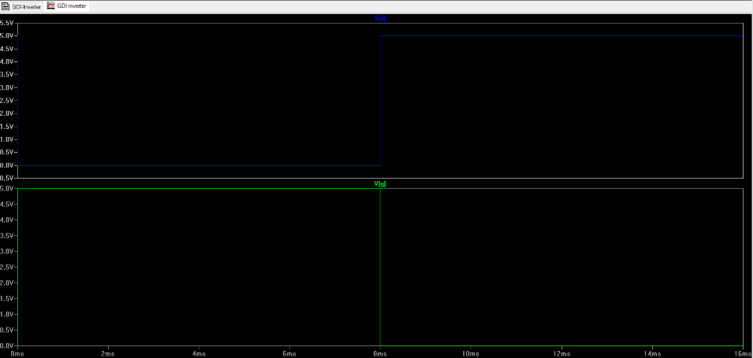
Gate-Diffusion-Input (GDI)
GDI as MUX GDI as Inverter

Slide 10
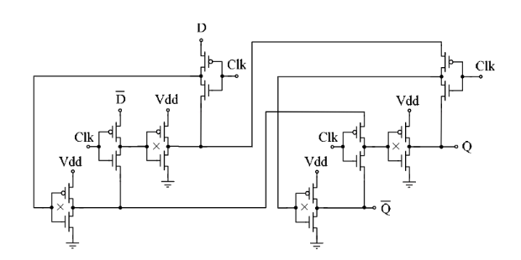
GDI-DFF Circuit

Slide 11
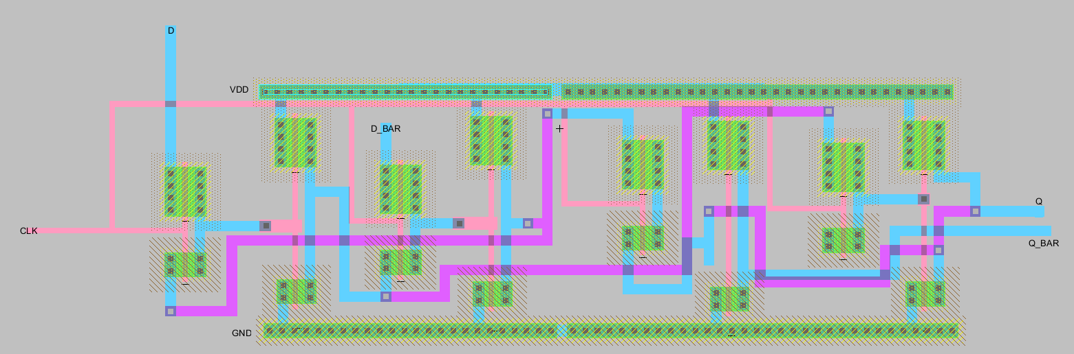
GDI-DFF Circuit
Layout: Used Electric GNU to create Layout.
Dimensions: PMOS W: 20 L: 2, NMOS, W: 10, L : 2. Unit: micron

Slide 12
Challenges Faced
The paper has delay in picoseconds but LTSpice has precision of microseconds.
Haven’t yet established the metrics for comparison.
Not sure how to find the power dissipated in multi-transistor system.

Slide 13
Citations:
Morgenshtein, Arkadiy, Alexander Fish, and Israel A. Wagner. "An efficient implementation of D-Flip-Flop using the GDI technique." 2004 IEEE International Symposium on Circuits and Systems (IEEE Cat. No. 04CH37512). Vol. 2. IEEE, 2004.

